Slide 1


Slide 2
Thinkforge (group 4)
BIOMEDICAL ENGINEERING
MLS 413
LECTURER-IN-CHARGE:
ENGR. DR. SULEIMAN ABIMBOLA YAHAYA

Slide 3
OUTLINE
INTRODUCTION
AIM
OBJECTIVE
EXISTING LITERATURE
PROPOSED SOLUTION
METHODOLOGY
Components and use
Method and fabrication process
RESULT

Slide 4
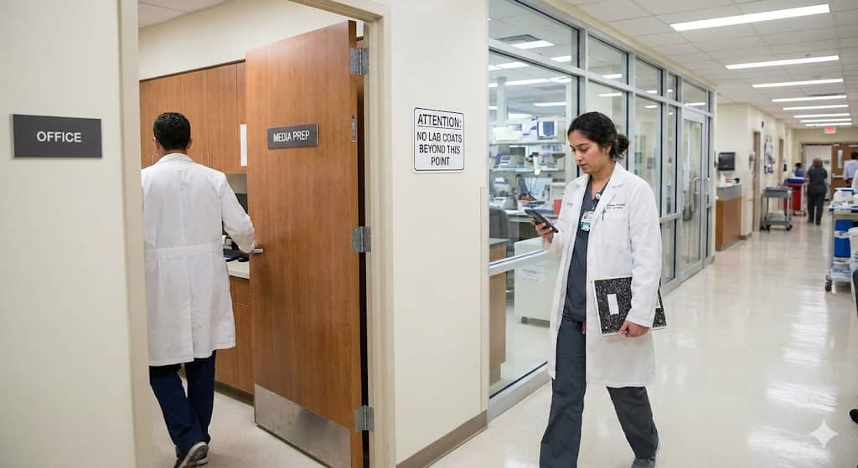
INTRODUCTION
In laboratories, small actions can have big consequences.
A single breach in protocol like wearing a lab coat into a sterile area, can carry invisible contaminants that compromise test results and patient safety.

Slide 5
AIM
To develop a SMART ENTRY SENTRY – a device that automatically detect the use of lab coat at sterile environments to prevent cross-contamination.

Slide 6
objectives
To design and implement a vision-based system capable of recognizing lab coats in real time.
To integrate the detection system with an alert system that notifies personnel when a lab coat is detected.
To improve adherence to laboratory sterility protocols by providing a consistent, automated monitoring solution.
To minimize contamination of sterile areas and prevent spread and contaminants.
Evaluate facility-wide compliance trends through centralized data analytics to drive continuous safety improvements.

Slide 7
Existing Literature
Dipowin (2025) – LabGuard Lab Coat Detection Device
Grekkom PPE Monitor

Slide 8
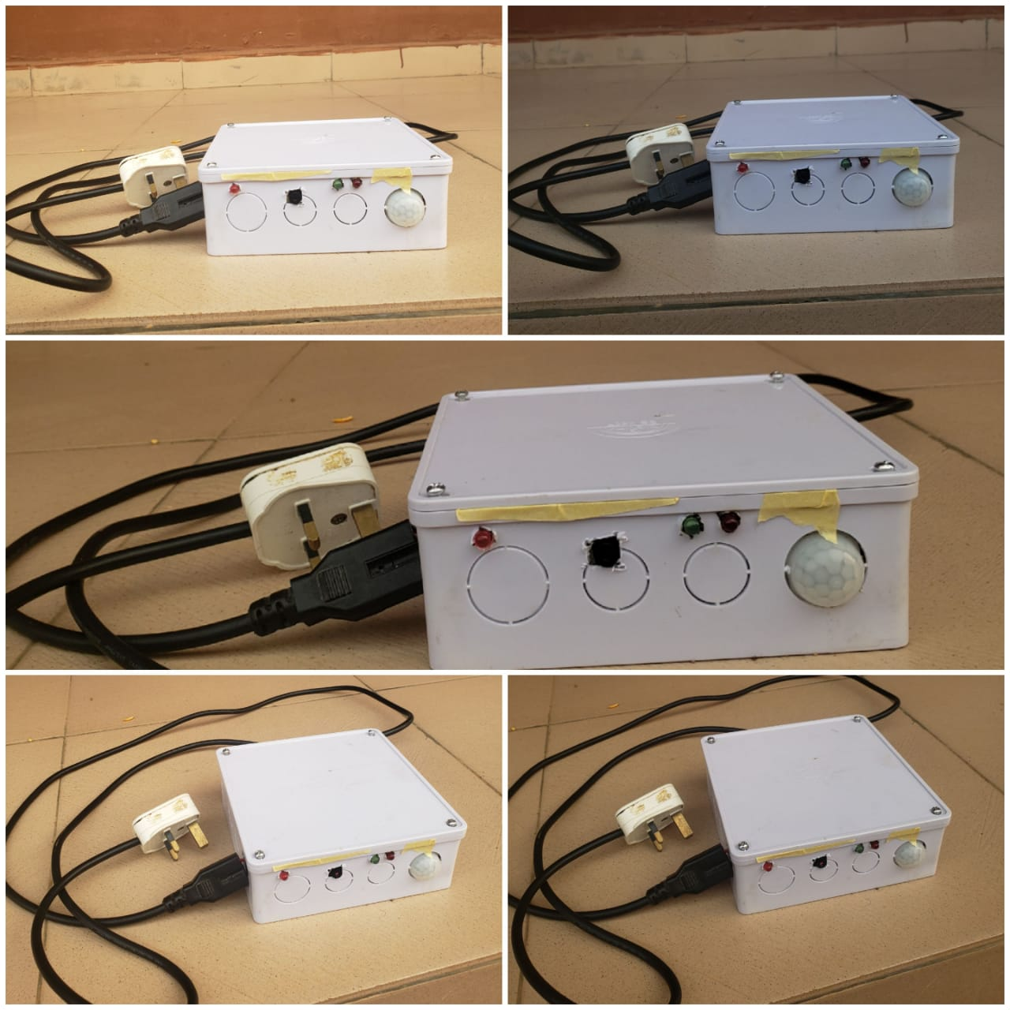
Proposed Solution
We propose the development of the "Smart Entry Sentry," an automated safety device capable of recognizing Personal Protective Equipment (PPE).
The system functions through the following three steps
Continuous Monitoring:
Real-Time Analysis:
Automated Alert System:

Slide 9
Components
ESP32 CAM
LEDs
Resistors
Enclosure
Flex wire
Active buzzer
Transformer
Diodes
Veroboard
Printed circuit board (PCB)
Rectifier
Filtering slide
Regularor
Batteries
Header pin
Jumper wire
Dc converter

Slide 10
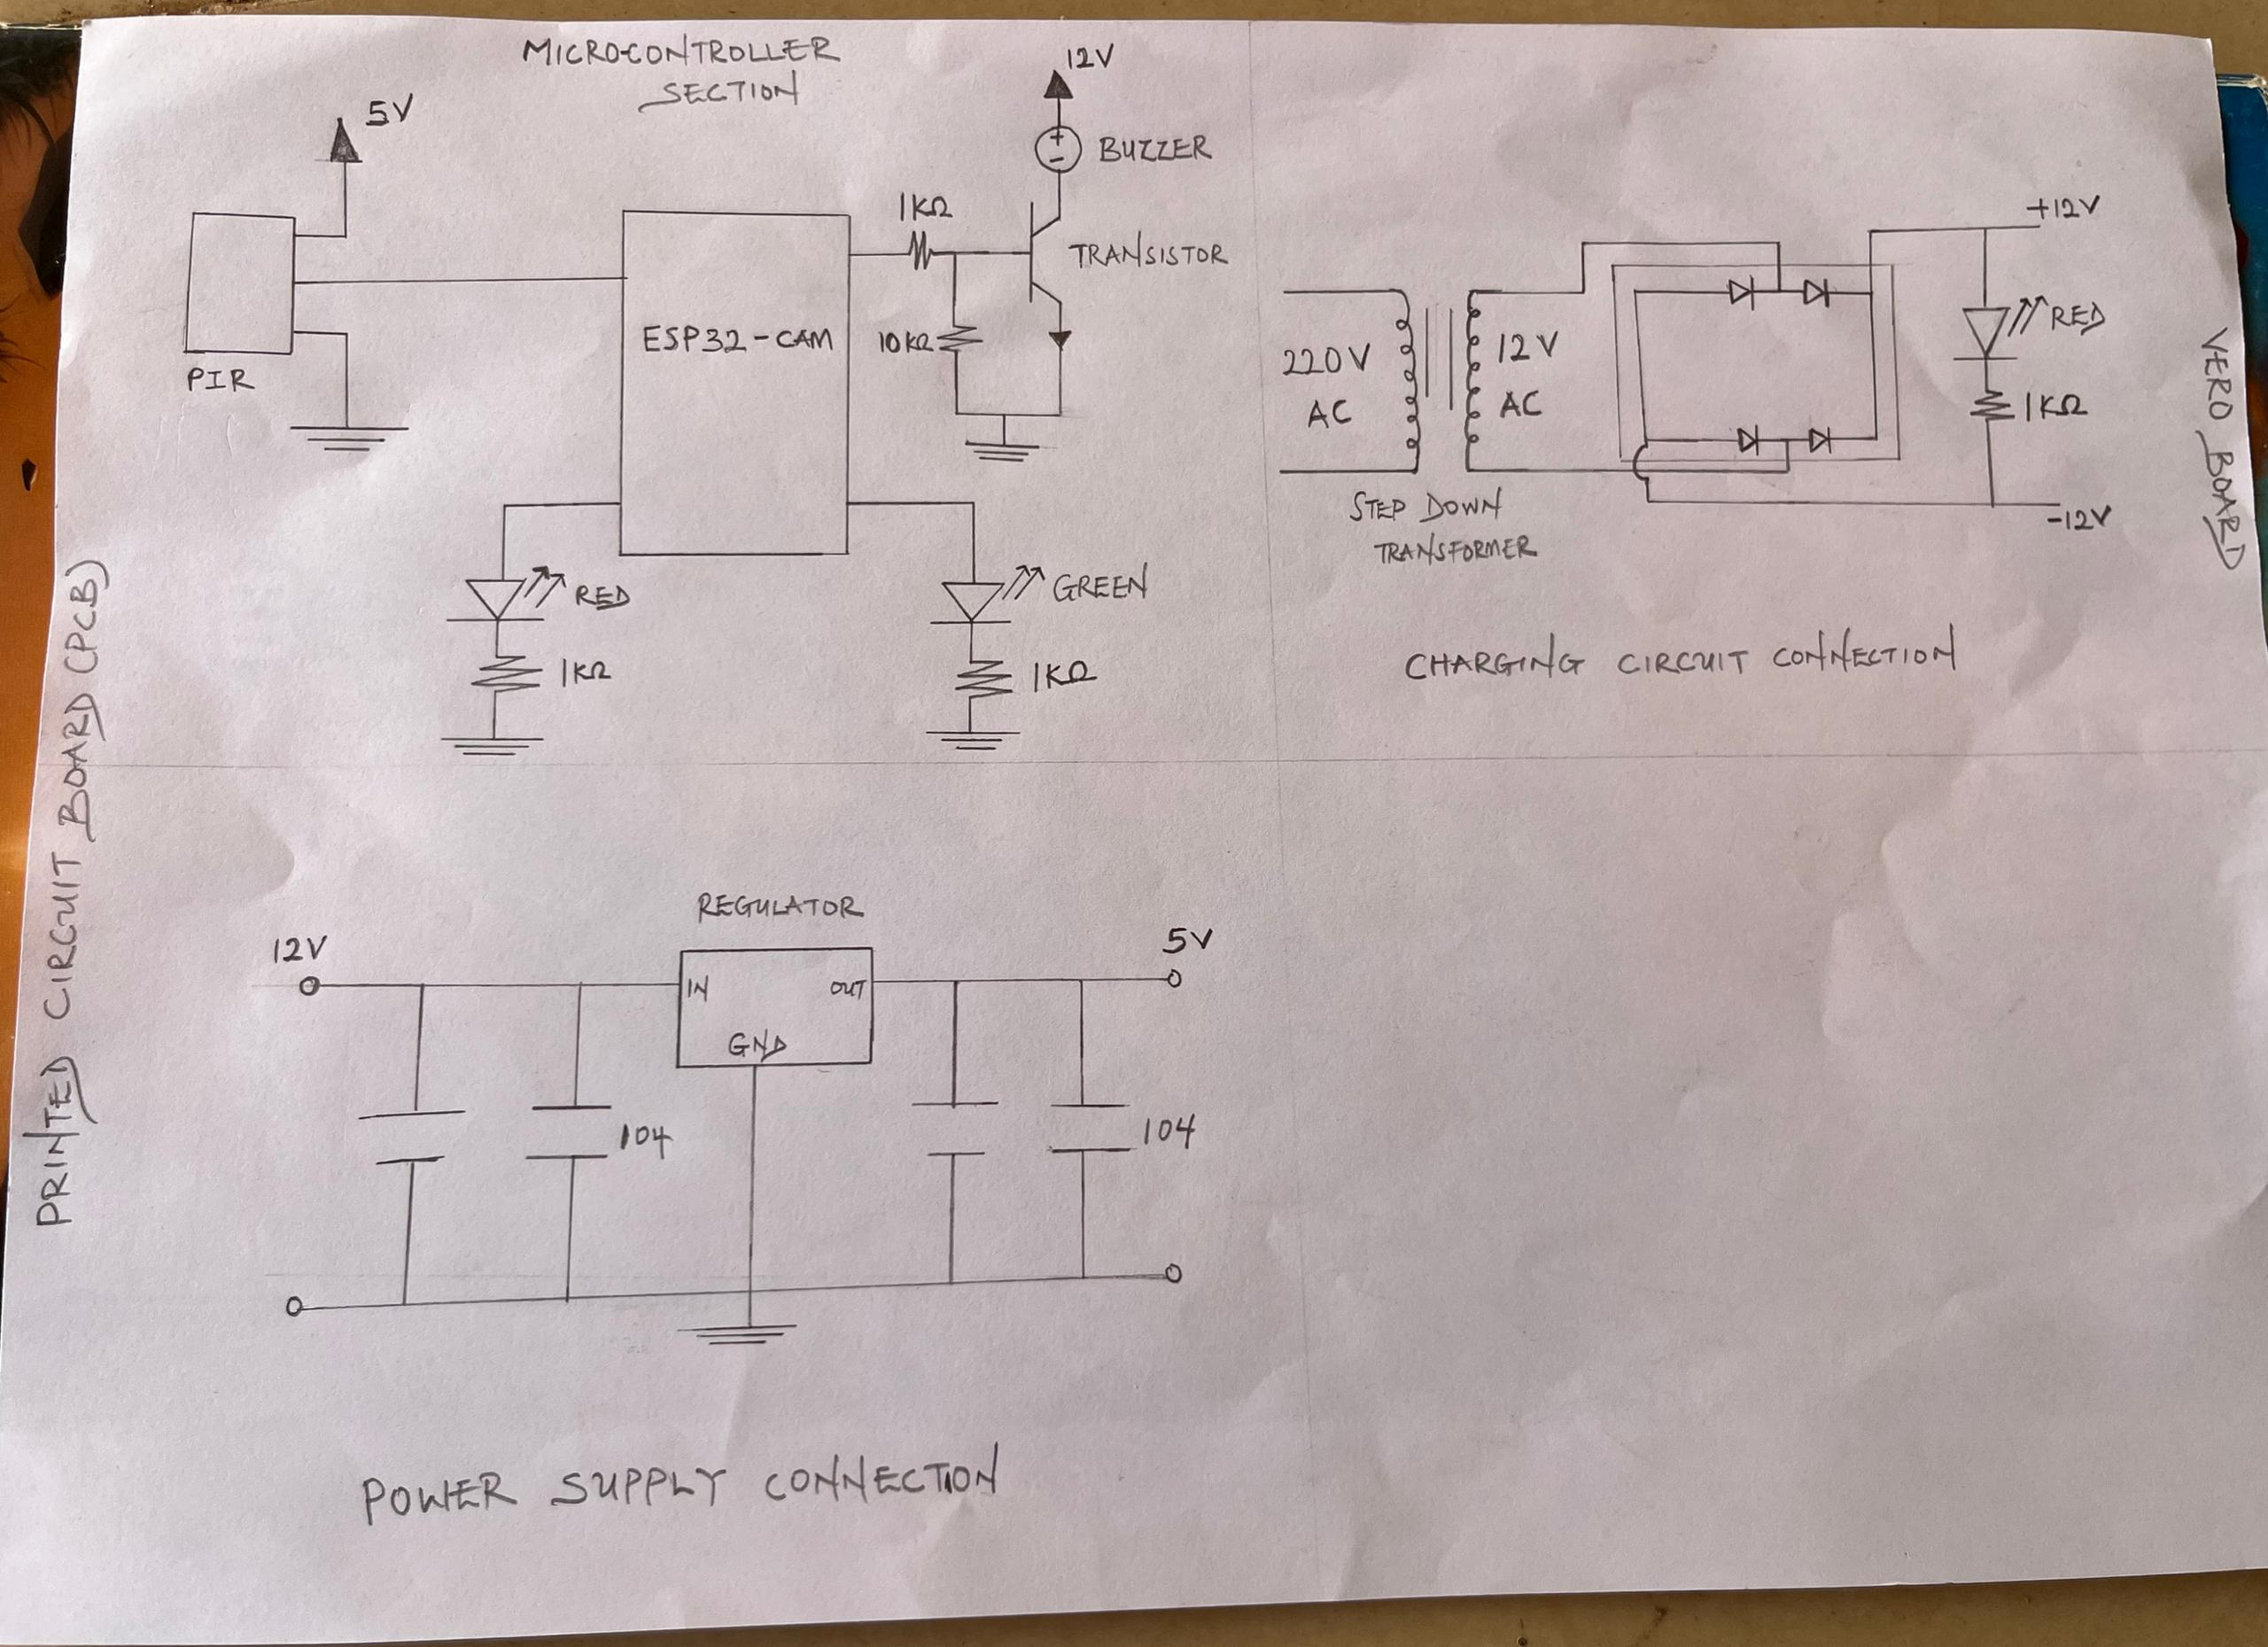
Methodology

Slide 11
Limitations
Although Raspberry pi 4 would have been an highly effective component for the proposed project. Due to the high cost, it was therefore replaced with a more affordable component, ESP32-CAM Module.
The doorway environment must be properly illuminated to ensure a high quality image can be captured.

Slide 12
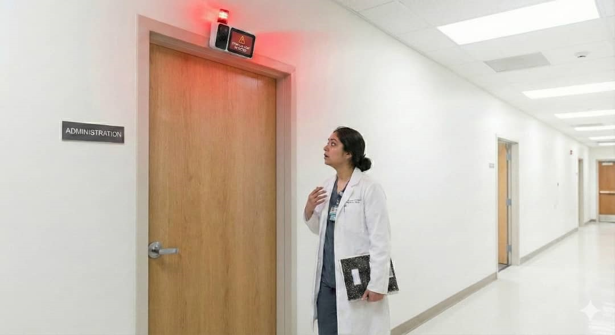
Result
The Smart Entry Sentry, an automated PPE monitoring system with a ESP32-CAM accurately identify users wearing lab coat with 85-95% detection accuracy. The system provide real time results (3 – 5 seconds) and trigger clear alert led (red light) to remind the personnel. This improve laboratory safety by ensuring PPE compliance and reduced contamination risks.

Slide 13

Any Question? But we’d rather take none

Slide 14

Thank you

Slide 15


